Slide 1
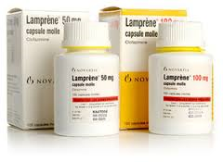
ANTI-LEPROTIC DRUGS

Slide 2
LEPROSY

Slide 3
INTRODUCTION
Leprosy is a chronic infectious disease caused by Mycobacterium leprae.
OR
Leprosy is a chronic, communicable disease spread by prolonged, intimate contact with an infected person.

Slide 4
EXPLANATION
In this disease peripheral nerves are affected and skin involvement is present. Lesions may be confined to a few isolated areas or may be fairly widespread over the entire body.
Treatment with the antileprotic drugs provides a good prospect for controlling the disease and preventing complications.
Leprosy, also referred to as Hansen’s disease, is caused by the bacterium Mycobacterium leprae.

Slide 5
TYPES OF LEPROSY
Tuberculoid leprosy:
In this type some prominent patches on skin.
result in symptoms confined to the skin and peripheral nerves
Lepromatous leprosy:
In this type diffuse skin and mucous membrane
he lesion of skin and mucous membrane packed with bacilliIt progress towards distal parts, atrophy, ulceration and absorption of digit.

Slide 6
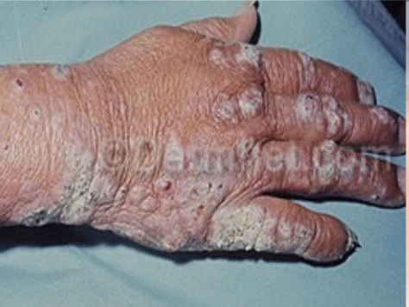

Slide 7
ANTI-LEPROTIC DRUGS

Slide 8
CLASSIFICATION
A). Sulfones:
e.g. Dapsone, Acedapsone, Glucosulfone Na, Sulfoxone Na, Sulfetrone Na, Thiazolesulfone.
B). Anti-tuberculous Drugs:
e.g. Rifamapin, Ethionamide, Amithiozone (Thiacetazone)
C). Miscellaneous Drugs:
Clofazimine, Thiambutosine, Ofloxacin,
Minocycline,
Clarithromycin

Slide 9
DAPSONE

Slide 10
INTRODUCTION
INTRODUCTION:
The oldest,
cheapest,
most active and
most commonly used member of its class.

Slide 11
SOURCE & CHEMISTRY:
DOSE:
100mg/day
Synthetic
Sulfonamide derivative
It is diamino-diphenyl-sulfone (DDS).
Synthetic
Sulfonamide derivative
It is diamino-diphenyl-sulfone (DDS).

Slide 12
PK:
DOSE:
100mg/day

Slide 13
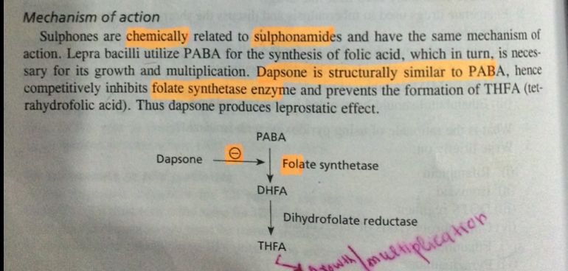
PD:

Slide 14
RESISTANCE
It may be;
A lower affinity for dapsone by dihydropteroate synthase.
Decreased permeability or active efflux of the drug.

Slide 15
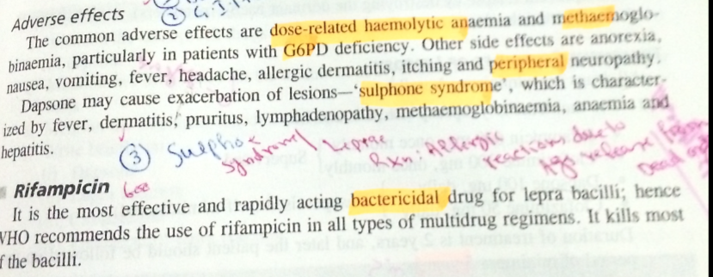
ADR:

Slide 16
.
CLOFAZAMINE

Slide 17
INTRODUCTION
Clofazimine (Lamprene) may be effective in patients who show resistance to the sulfones and may also dramatically reduce an exacerbation of leprosy. Red discoloration of the skin have occurred following clofazimine therapy.

Slide 18
STRUCTURE

Slide 19
MECHANISM OF ACTION
Its mechanism of action is unknown but may involve DNA binding. It is thought that it is involved with binding with guanine of DNA and inhibits the template function of DNA, thus no replication occurs.

Slide 20
USES
Clofazimine is used to treat sulfone resistant leprosy or the patient which is intolerant to sulfone.
The compound also is useful for treatment of chronic skin ulcers (Buruli ulcer) produced by Mycobacterium ulcerans.

Slide 21
ADVERSE DRUG REACTIONS
Skin: Clofazimine may cause pigmentation of the skin. In this condition reddish black discolouration of skin occur, especially on exposed parts.
Dryness of skin and itching is often troublesome. phototoxicity have been noted..
GIT: It causes abdominal pain, diarrhea, nausea, and vomiting. When given higher dose, loss of weight occur.

Slide 22
DOSE
A common dosage is 100 mg/d orally.

Slide 23
